Slide 1

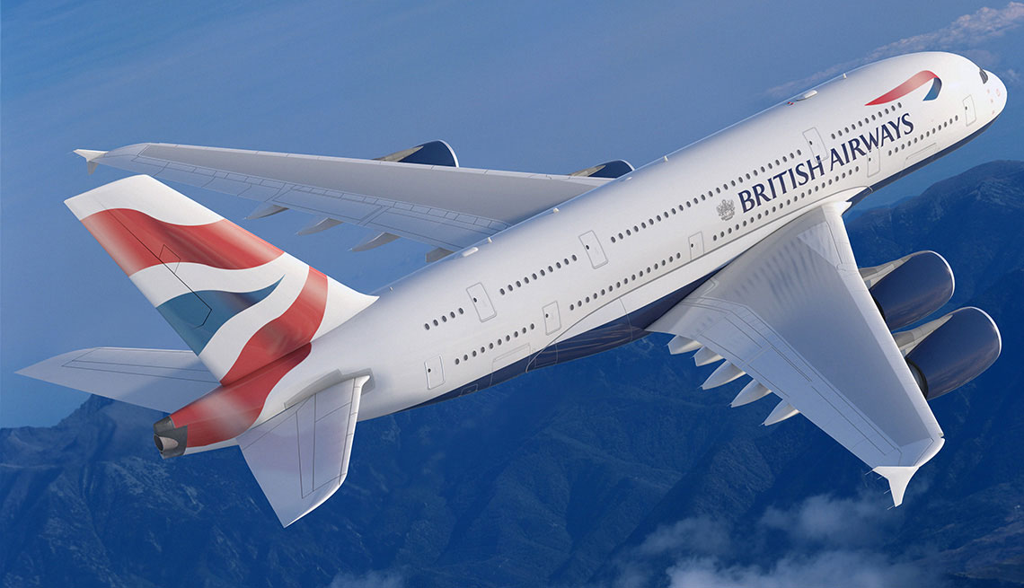
Customer Reviews & Emotions Analysis
Customer Review | 2023

Slide 2
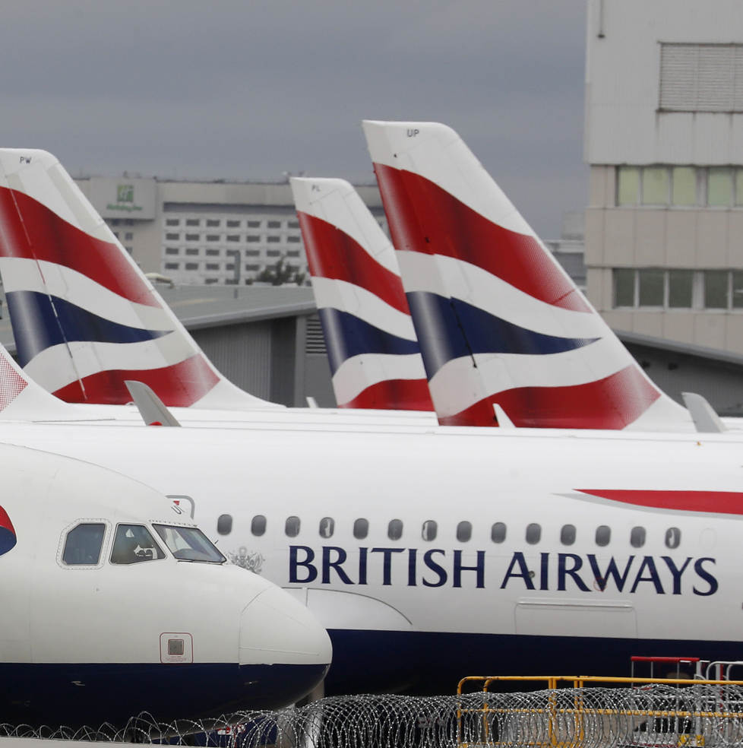

Prablem
The UK's national airline, British Airways (BA), operates as the flag carrier and manages an extensive daily flight schedule that facilitates travel across the globe for numerous customers. Managing the full spectrum of tasks such as scheduling, planning, boarding, fueling, transporting, and ensuring timely arrivals with impeccable customer service requires a significant level of responsibility and efficiency.
Customer Review | 2023

Slide 3
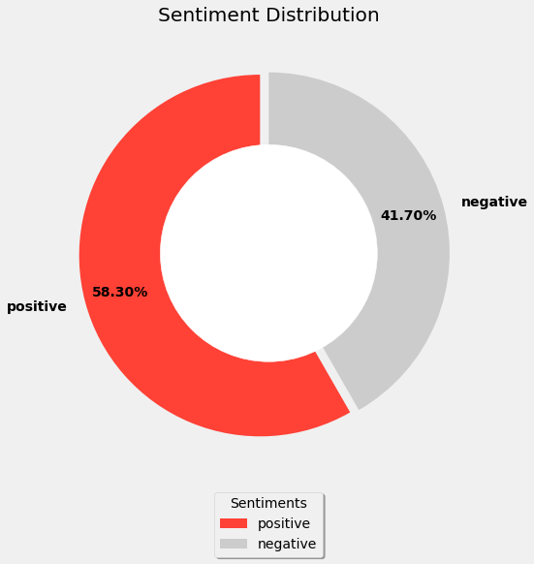
Sentiment Scores
The sentiment distribution reveals that 58.30% of customers expressed a positive sentiment in their reviews, while 41.70% expressed a negative sentiment. This indicates that the majority of customers provided positive feedback, but it is also important to pay attention to and address reviews with negative sentiment.
Customer Review | 2023

Slide 4
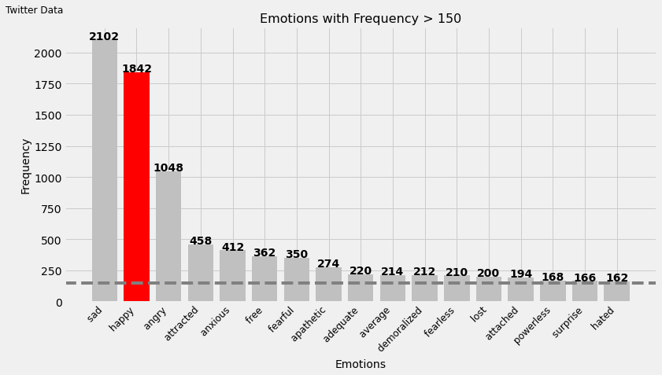
Frequency Emotions
Among the frequent emotions, "happy" was expressed by 1,842 people, while "sad" was expressed by 2,012 people.
Customer Review | 2023

Slide 5
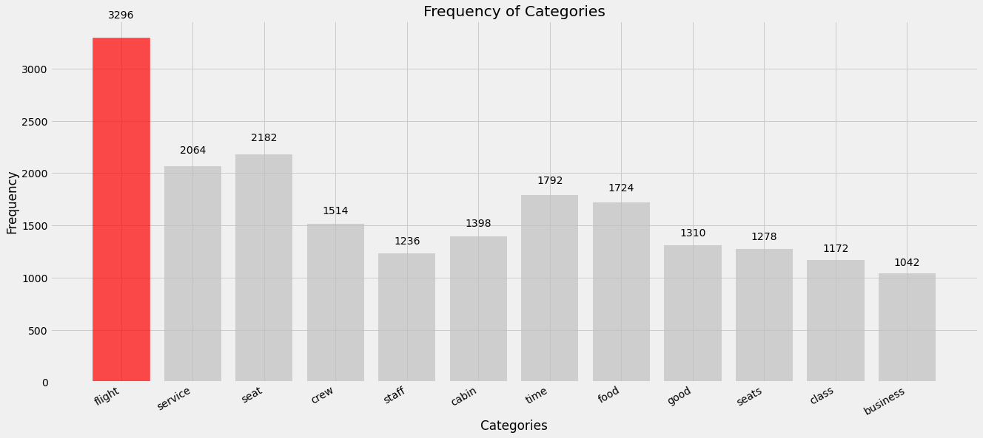
Frequency Categories
Among the frequent categories, "flight" was ranked first with 3,296 mentions.
Customer Review | 2020

Slide 6
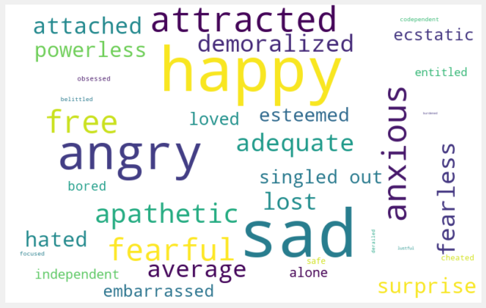

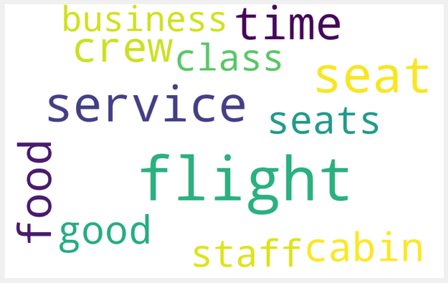
Word Cloud
Word Cloud for Emotions
Word Cloud for Categories
Business Review | 2020

Slide 7

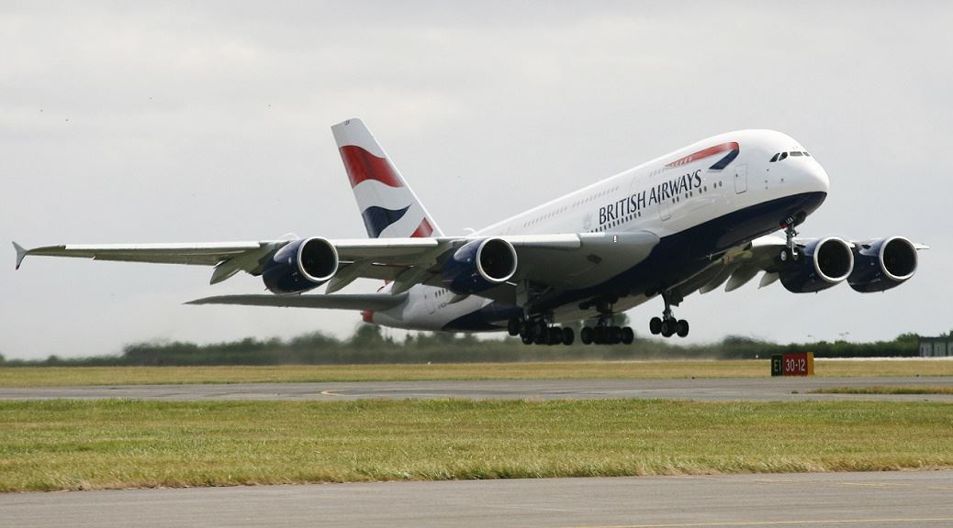
Thank you!
Customer Review | 2023

